Slide 1

Objectives
In this session, you will learn to:
  Identify the need, scope and building blocks of UML
  Identify the types of UML diagrams
Notes:
Explain the session objectives to the students.
Bring about the need of UML by providing the analogy of an architect who has acquired the contract of a building. Compare the analogy with designing software systems using UML.

Slide 2
Overview of UML
Unified Modeling Language (UML) is a standard language for creating blueprints that depicts structure and design of the software system.
You can use UML for modeling systems that can range between enterprise information systems to distributed
Web-based applications.
There are several tools available, such as Rational Rose, Jude, AgroUML, Visio, and Poseidon, which you can use to design software systems by using UML.
Notes:
Initiate a discussion by asking the students the purpose of OOAD. Then explain that OOAD is a technique for analyzing the requirements and creating the design for a software system. Tell the students that UML is the standard language used for modeling the structure and design of a software system. UML provides a variety of diagrams to represent the structure and design of a software system.
List the common UML tools available and tell the students that this course uses Microsoft Visio as the UML tool.

Slide 3
Evolution of UML
During the mid 1970s and late 1980s:
  Object-oriented modeling languages were developed for analysis and design of the software.
  The most prominently used languages were:
    Booch’s Booch’93
    Jacobson’s Object Oriented Software Engineering (OOSE)
    Rumbaugh’s Object Modeling Technique-2 (OMT).
  In October 1994, the unification of Booch’93, OMT, and OOSE led to the release of version 0.9 and 0.91 of UML.
Notes:
List the three main modeling languages developed in the specified period. Tell the students that each of these languages had certain strengths and weaknesses. Booch’93 was efficient in projecting the software system during the design and construction phases. OOSE was more helpful in the requirements capturing and analysis phases. OMT was helpful for the analysis of data-intensive information systems.
Because different languages were being used, all having their own strengths and weaknesses, the three languages were unified to create a single standard language. As a result, UML was formed. The initial version of UML was UML 0.9. Since then, several versions have been released. This course is based on UML 2.0.

Slide 4
Scope of UML
Rational Software Corporation defines UML as follows: “The Unified Modeling Language (UML) is a language for specifying, constructing, visualizing, and documenting the artifacts of a software-intensive system.”
Artifacts include requirements, architecture, design in terms of classes, objects or interfaces, source code, tests, prototypes, and the software releases of a software system.
UML can be defined as a language for:
  Specifying artifacts
  Visualizing artifacts
  Constructing artifacts
  Documenting artifacts
Notes:
Explain the definition of UML as given by Rational Software Corporation. Tell the students that Rational Software Corporation has now been acquired by IBM and is now a division of IBM. Explain how UML can be used for specifying, visualizing, constructing, and documenting artifacts by using the information given in the student guide.
After discussing the scope of UML, you can discuss the areas where UML may not be applicable. The following information throws more light on this topic.
You use UML diagrams to visualize a system from various aspects. However, UML might not be useful in certain situations and, therefore, may not help depict a system completely. For example, UML does not provide any graphical notations to depict the screen flow diagrams. The screen flow diagrams depict the various graphical user interface (GUI) screens used in the software system and the flow between the screens
.
Similarly, you may find that UML is not suitable for developing models for function-oriented systems. UML is an object-oriented modeling technique that involves the design in terms of classes, objects, and their relationship, interaction, and states. Function-oriented systems do not involve the usage of classes or objects and, therefore, UML is not suitable for developing such software systems.
Earlier versions of UML were not suitable for modeling real-time systems. This is because real-time systems require precise measurements to depict the request and response time, which are critical for the functioning of such systems. However, UML (1.x) diagrams do not provide notations for the request and response time. In UML 2.0, some new diagram types have been included to depict the design of real-time systems.

Slide 5
Building Blocks of UML
UML building blocks include:
  Basic UML constituents: Include the static, dynamic, grouping, and annotational constituents of UML.
  Relationships: Depict the relations between various constituents of a UML model.
  Diagrams: Represent the various artifacts of a system graphically.
Notes:
Take up the building analogy to explain the constructs used to build UML models. For further details, refer the student guide.

Slide 6
Identifying the Types of UML Diagrams
UML provides the following thirteen diagrams to represent the structure and design of a software system:
  Use case diagrams
  Class diagrams
  Object diagrams
  Communication diagrams
  Sequence diagrams
  State Machine diagrams
  Activity diagrams
  Package Diagrams
  Component diagrams
Notes:
List the thirteen UML diagrams.

Slide 7
Identifying the Types of UML Diagrams (Contd.)
  Deployment diagrams
  Timing Diagrams
  Composite Structure Diagrams
  Interaction Overview Diagrams
Notes:
Tell the students that three of these diagrams (Timing, Composite Structure, and Interaction Overview diagrams) were not there in earlier versions of UML and have been added in UML 2.0.

Slide 8
Defining Use Case Diagrams
A use case diagram:
  Depicts the various operations that a system performs.
  Contains use cases, actors, and their relationships.
Order Parts
Inventory Department
Accept Supply
Notes:
Use the use case diagram given on the slide to explain the meaning and notations for actor, use case, and relationship.

Slide 9
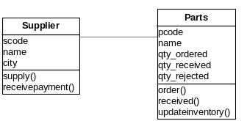
Defining Class Diagrams
A class diagram represents a set of classes, interfaces, and their relationships.
Notes:
Use the class diagram given in the slide to explain the symbol for a class. Also explain attributes, methods, and relationships.

Slide 10
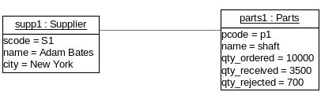
Defining Object Diagrams
An object diagram represents an instance of a class diagram.
Notes:
Use the object diagram given on the slide to explain the symbol for an object. Tell the students that an object does not contain methods because methods remain same for all objects of a class.

Slide 11
Defining Communication Diagrams
Communication diagrams represent interaction between objects in the form of messages.
1. Places Order
supp1: Supplier
2. Supplies Order
Inventory Department
Notes:
Use the communication diagram given on the slide to explain how messages flow between various objects.

Slide 12
Defining Sequence Diagrams
Sequence diagrams represent interaction between objects in the form of messages ordered in sequence by time.
Inventory Department
supp1: Supplier
1. Places Order
2. Supplies Order
Notes:
Use the sequence diagram given on the slide to explain how messages flow between various objects. Explain the difference between sequence diagrams and communication diagrams.

Slide 13
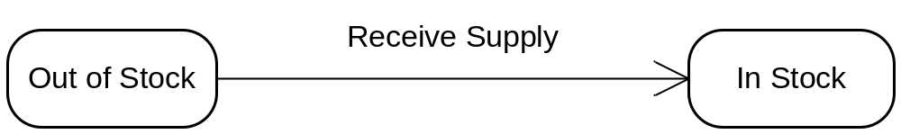
Defining State Machine Diagrams
A state machine diagram shows how a class reacts when an event occurs.
Notes:
Use the state machine diagram given on the slide to explain the transition between the states of a class.

Slide 14
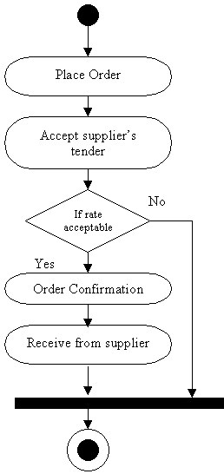
Defining Activity Diagrams
Activities are a representation of various operations performed by a class.
An activity diagram depicts the flow of control from one activity to another.
Notes:
Use the activity diagram given on the slide to explain the flow of control from one activity to another.

Slide 15
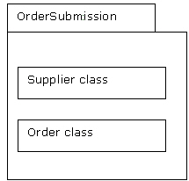
Defining Package Diagrams
All the interrelated classes and interfaces of the system when grouped together form a package.
Package diagrams represent all these interrelated classes and interfaces.
Package diagrams help in representing the various packages of a software system and the dependencies between them.
Notes:
Explain the components of the package given in the figure. Tell the students that Supplier class and Order class have been combined to form the OrderSubmission Package.

Slide 16
Defining Component Diagrams
You combine packages or individual entities to form components.
A component diagram depicts various components and their dependencies.
Order.cs
<<executable>>
Orderprocess
processsupply.cs
Notes:
Explain the component diagram given on the slide by telling the students that the orderprocess executable component regulates the order and supply procedure. It depends on the order.cs file for placing an order and on the processupply.cs file for processing the supply received.

Slide 17
Summary
In this session, you learned that:
  Unified Modeling Language (UML) is a standard language for creating blueprints that depict the structure and design of the software system. It is used to specify, visualize, construct, and document the artifacts of a software system.
  The building blocks of UML consist of basic constituents, relationships, and diagrams. The basic constituents include the structural, behavioral, grouping, and annotational constituents.
  UML diagrams enable you to visualize the software system by graphical representation of the various constituents.
Notes:
Summarize the session by using the summary points given in the slide.

